Slide 1
Intro to SQL and Databases
Maddy Chellathurai & Randi Ludwig
17th August 2017

Slide 2
Getting Started

Slide 3
Join Slack Channel
Go to https://women-in-ds-atx.slack.com
Click ‘Channels’
Click ‘2017-08-17-workshop’
Click ‘Join Channel’
If you are struggling with any part of the installation, ask for help!

Slide 4
Clone the GitHub Repository
This is a good way to build up your activity on GitHub!
Log into your account and fork the repo on github.com/womenindatascienceatx
Click the Clone or Download button and copy the link
Open a command line on your machine and navigate to wherever you’d like to save your work
rludwig$ cd Desktop/MeetupProjects
Clone the repo
rludwig$ git clone <paste link here>

Slide 5
Commit to GitHub
Every time you want to make a remote backup of your work, push to GitHub from the command line.
>git pull
>git add -A
>git commit -am “comment about changes”
>git push
At the end of today’s workshop, remember to push your changes!

Slide 6
What’s the Deal with SQL?

Slide 7

Why Should a Data Scientist Know Databases?
You don’t often get to pick.
SQL can be a powerful tool. Data Scientists need broad toolkits.
80% of Data Science is getting the data ready for modeling. SQL can help with a lot of that and it’s fast.
Notes:
This is also one of the skills Data Scientists are most lacking, so it can help you stand out!

Slide 8
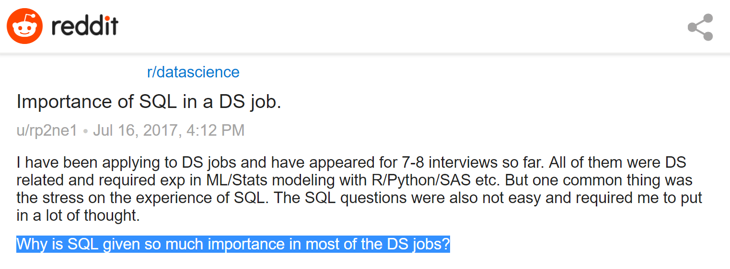
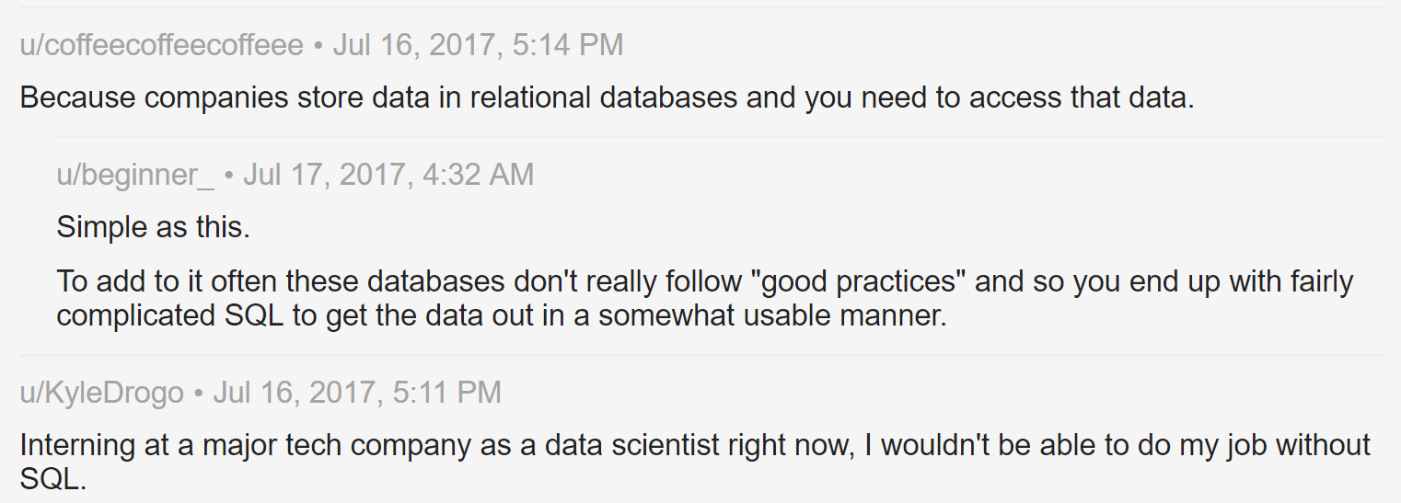

https://amp.reddit.com/r/datascience/comments/6npcxb/importance_of_sql_in_a_ds_job/

Slide 9
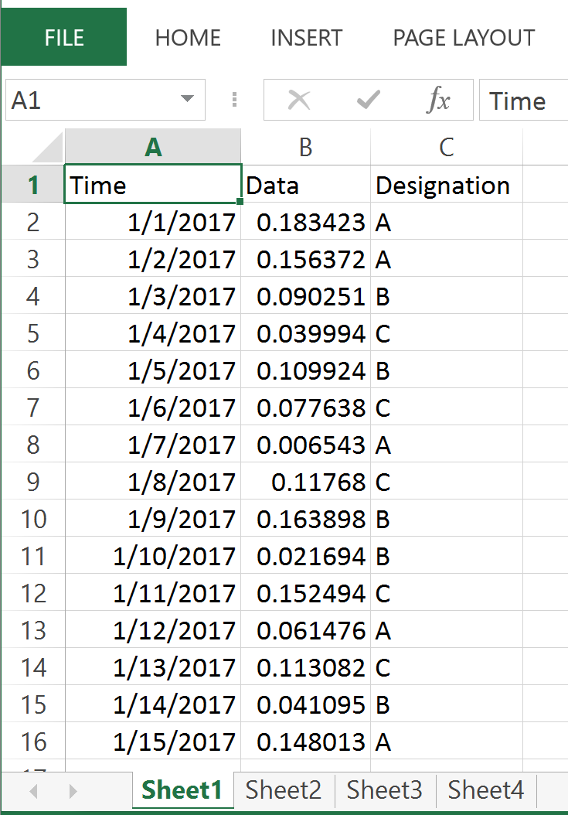
What?
Database
Collection of interrelated data
Like an Excel file (kind of)
Tables
Single set of data
Like a sheet within an Excel file (kind of)
Can be interrelated or independent

Slide 10
Why?
Why not just use files?
data redundancy & inconsistency
accessing data
data isolation
integrity

Slide 11
How?
Data abstraction
Physical level (blocks of data on disk)
Logical level (types of data, interrelationship)
View level (from web, or UI)
Instance - collection of info at that particular moment
Schema - overall design

Slide 12
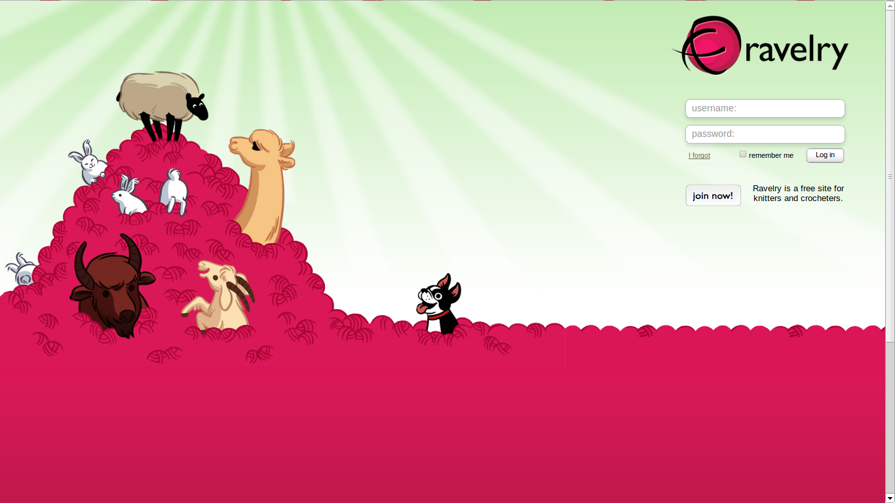
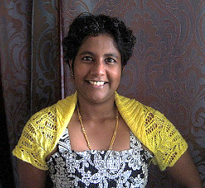
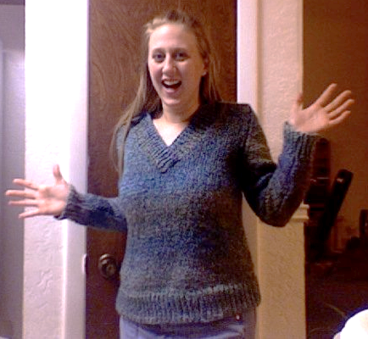
Example

Slide 13
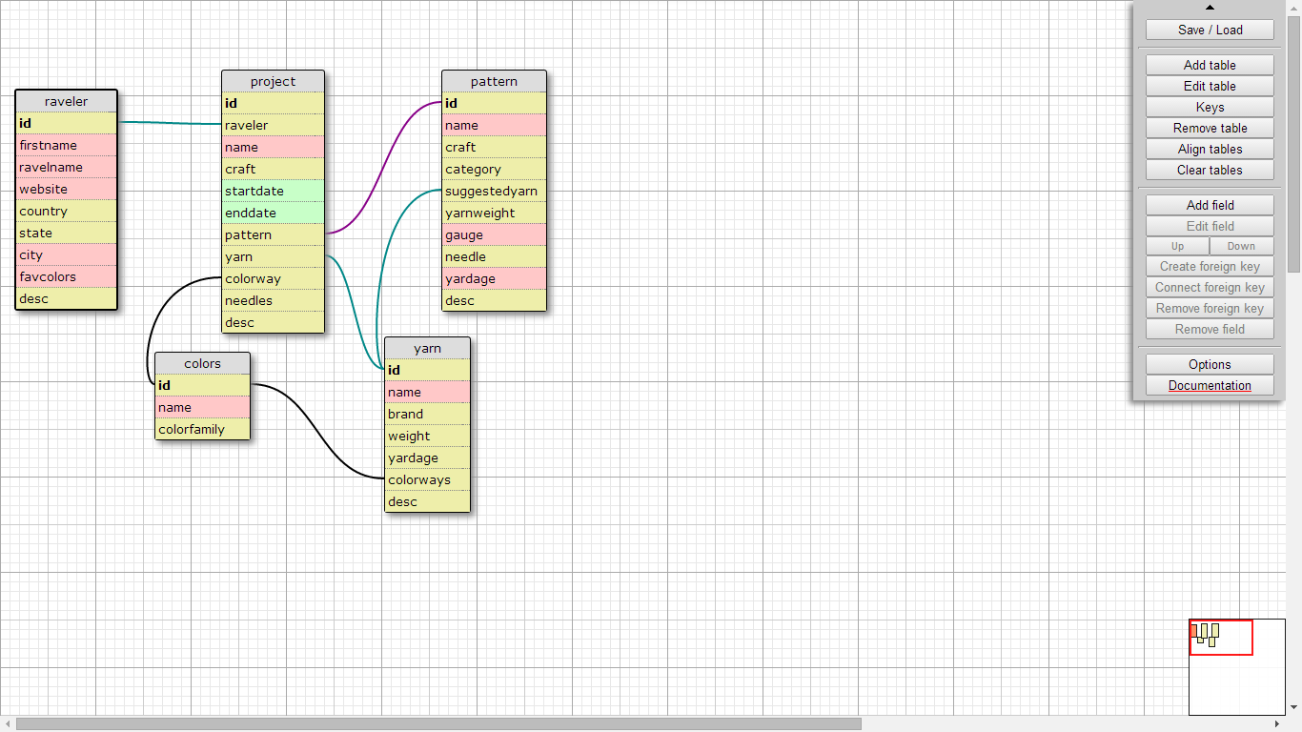
http://ondras.zarovi.cz/sql/demo/

Slide 14
Keys:
Primary key (id)
enforces the entity integrity of the table and guarantees uniqueness of data
one table can have only one primary key
multiple columns can make a primary key
usually identity column is primary
Foreign key (shown as lines):
used to establish and enforce a link between the data in two tables
Notes:
Not sure we need this

Slide 15
Main parts of SQL
Data definition language(DDL): Defining & modifying schemas, creating indices, deleting relations.
Data manipulation language(DML): insert, update, delete.
Authorization
Transaction control
Notes:
Not sure we need this

Slide 16
Let’s cast on!

Slide 17
Create database..
Mac and Linux users
on prompt type sqlite3 <anyname>
for eg: sqlite3 ravelry.db
Windows users
on cmd prompt type : sqlite3
.open <anyname>.db <extension is important>
Notes:
Fix to match frontmatter

Slide 18
Create table
on sqlite prompt:
.tables (you should not see any, this is like ‘ls’)
CREATE TABLE country (
id INTEGER PRIMARY KEY AUTOINCREMENT,
name VARCHAR,
code INTEGER
);
.tables
Note: common data types are INTEGER, VARCHAR, DATE, etc..
https://www.sqlite.org/datatype3.html

Slide 19
INSERT values into table
on sqlite prompt:
INSERT INTO `country` (`name`,`code`)
VALUES ('United States of America', 'USA');
NOTE: no need to specify id, since we specified the field value as autoincrement.
NOTE: sqlite quotes: ` when referencing columns ‘ when referencing string data.
Exercise: insert a row into table country.

Slide 20
SELECT values
on sqlite prompt try the following queries:
SELECT * FROM country;
SELECT name FROM country;
SELECT name AS `country name` FROM country;
SELECT country.name AS `cname` FROM country;
Note: convention is to have keywords in CAPS
https://www.sqlite.org/lang_keywords.html

Slide 21
WHERE clause
on sqlite prompt try the following queries:
SELECT * FROM country WHERE id=1;
SELECT name FROM country WHERE code =’USA’;
Notice sometimes you’re pulling a row and sometimes you’re pulling a value.
NOTE about sqlite quotes ` when referencing columns ‘ when referencing string data.

Slide 22
Update values
UPDATE country SET name=’United States of America’;
will update *ALL* rows
so we have to specify identifier id (usually primary key)
UPDATE country SET name=”United States of America” WHERE id=1;
Run a select statement to see if row data has been modified.
Notes:
Move to end?

Slide 23
so far
we know how to
CREATE a table (DDL)
INSERT data (DML)
SELECT data (DML)
UPDATE data (DML)

Slide 24
good to know sqlite commands
.help
.backup <anyname.db>
.restore <anyname.db>
.tables
.schema <tablename>
.quit
.exit
.timer

Slide 25
need more data
.open wids_ravelry.db

Slide 26
Take a look at your data
.tables
.schema <tablename>

Slide 27
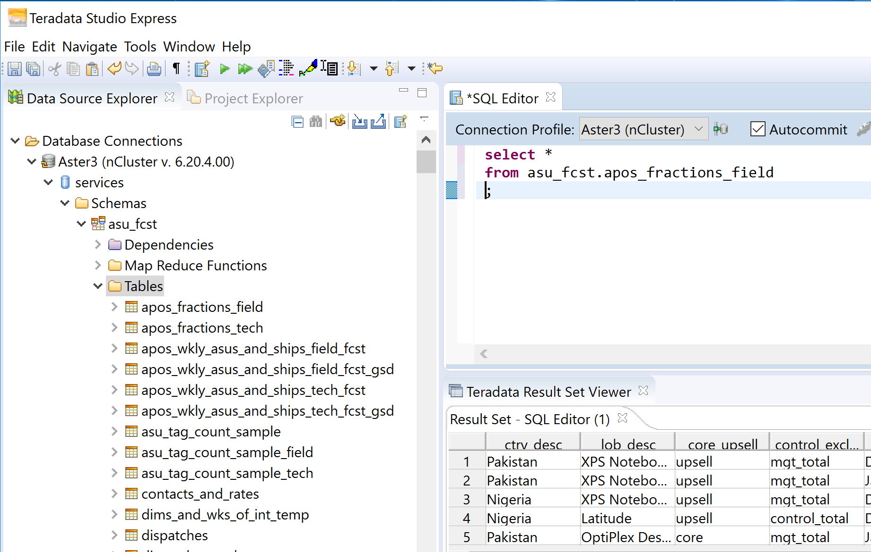
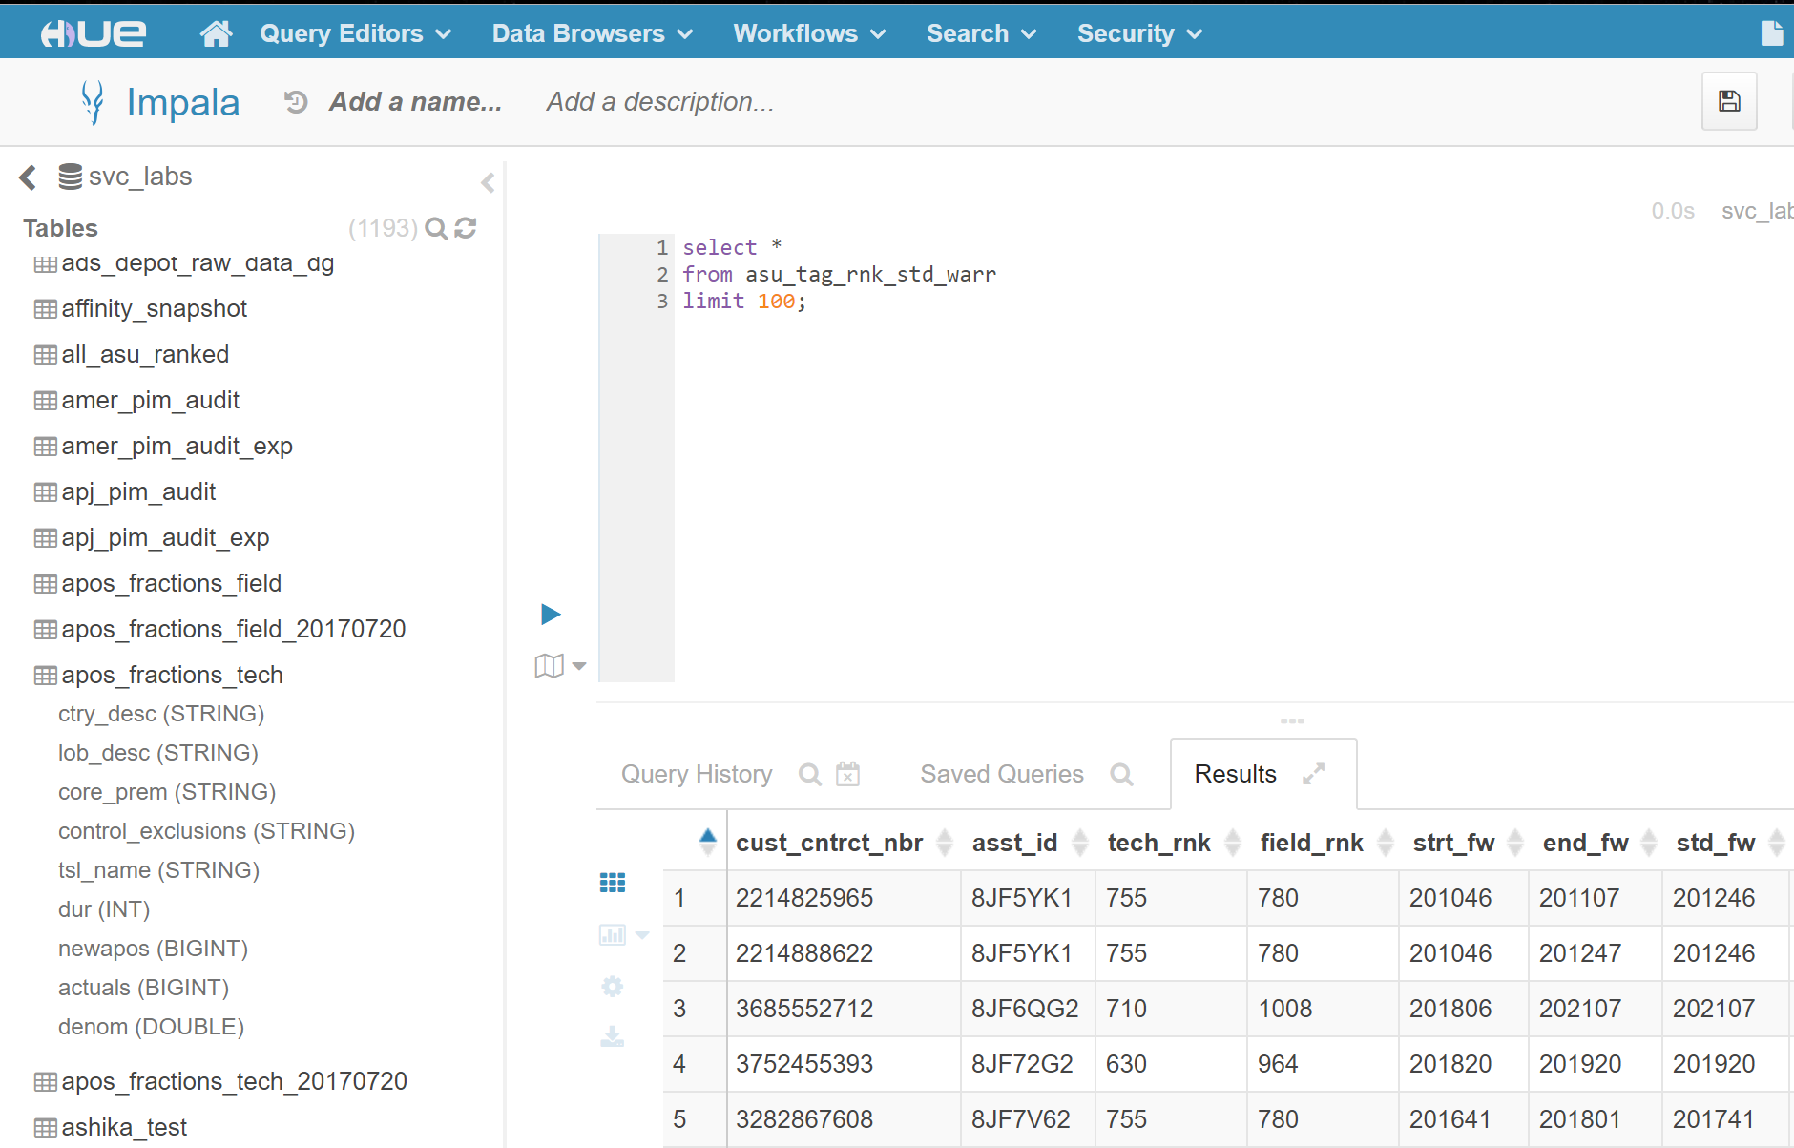
SQL Interfaces

Slide 28
Aggregate Functions
Typical summary stats:
Min, Max, Avg, Count, Sum
No Median
Whole table
Within table - need to know how to aggregate, i.e. Group By
SELECT count(*)
FROM yarn
SELECT weight,
avg(price)
FROM yarn
GROUP BY weight;

Slide 29
Built in functions
Aggregate functions https://www.sqlite.org/lang_aggfunc.html
avg(<column_name>)
count(<column_name or *>)
Core functions https://www.sqlite.org/lang_corefunc.html
abs(<column_name>)
random()
Date and time functions https://www.sqlite.org/lang_datefunc.html
date(‘now’)
datetime(‘now’)
Exercise: Try some built in functions.

Slide 30
Exercises
Write queries to verify number of rows in 2 tables.
Write query to find the total yardage per brand

Slide 31
Answers
Color 405, country 247, etc.
‘Dream in Color’ 3460, ‘Malabrigo’ 335, ‘Malabrigo ‘ 2884

Slide 32
Joins
Combine results of 2 or more tables.
Try it out: Display state along with country name
SELECT state.*,
country.name
FROM state
JOIN country
ON state.countryid = country.id;
* means all columns in table
Notes:
.save ravelry.db and add states not in the US

Slide 33
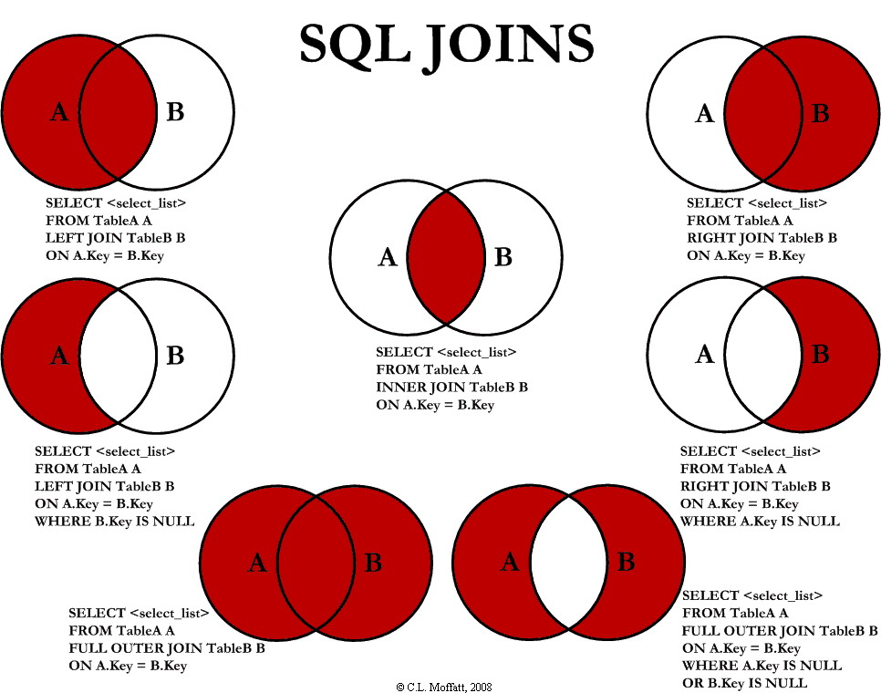
Exercise: Try some different types of joins. Notice how your results change.

Slide 34
Exercises
Change the type of join from the previous SQL statement
Find all states with country id = 233
Find names of project by user id =14
Find all projects by user id =14 with user name
Find all number of unique yarns used in all projects
Find total price of all yarns
Find total price of all yarns per brand

Slide 35
Answers
select state.name from state where countryid=233;
select name from project where raveler=14;
select project.name, raveler.firstname from project, raveler where raveler.id=14 and raveler.id=project.raveler;
select count(distinct yarn) from project;
select sum(price) from yarn;
select sum(price),brand from yarn group by brand;

Slide 36
More Complicated SQL
Over the year, how many projects were competed by each raveler per month, and how much yarn did they use?
Who were the top ten ravelers to complete projects as a percentage of the total number completed by all ravelers in any month.

Slide 37
More Complicated SQL
WITH tot AS (
SELECT TRIM(SUBSTR(prj.enddate,1,2),'/') AS endmonth,
COUNT(prj.id) AS proj_complete,
SUM(pat.gauge) AS tot_yarn
FROM project AS prj
LEFT JOIN pattern AS pat
ON prj.pattern = pat.id
GROUP BY TRIM(SUBSTR(prj.enddate,1,2),'/')
),
ind AS (
SELECT rav.ravelname,
TRIM(SUBSTR(prj.enddate,1,2),'/') AS endmonth,
COUNT(prj.id) AS proj_complete,
SUM(pat.gauge) AS tot_yarn
FROM project AS prj
LEFT JOIN pattern AS pat
ON prj.pattern = pat.id
LEFT JOIN raveler AS rav
ON rav.id = prj.raveler
GROUP BY rav.ravelname,
TRIM(SUBSTR(prj.enddate,1,2),'/')
)
SELECT ind.ravelname,
ind.endmonth,
ind.proj_complete AS indiv_proj,
-- SUM(ind.proj_complete) OVER ( PARTITION BY ind.ravelname ORDER BY ind.endmonth ) AS yearly_proj,
tot.proj_complete AS tot_proj,
ROUND(ind.proj_complete*100./tot.proj_complete,1) AS proj_perc,
ind.tot_yarn AS indiv_used,
tot.tot_yarn AS tot_used,
ROUND(ind.tot_yarn*100./tot.tot_yarn,1) AS yarn_perc
FROM ind
LEFT JOIN tot
ON ind.endmonth = tot.endmonth
ORDER BY proj_perc DESC
LIMIT 10;

Slide 38
Many Flavors of SQL
MySQL, PostgreSQL, Oracle, HiveQL…
Like python 2 vs 3
https://stackoverflow.com/questions/1326318/difference-between-different-types-of-sqlot

Slide 39
Read more
Don’t forget to push your work to GitHub!
http://www.w3schools.com/sql/
http://www.sql-tutorial.net/
https://docs.python.org/2/library/sqlite3.html
https://pypi.python.org/pypi/python-sql
http://www.sqlalchemy.org/
Or email us mazhalai@gmail.com & randirl17@gmail.com

Slide 40
Additional Materials…

Slide 41
Additional SQL Commands
Delete
Alter Table
Drop Table

Slide 42
Delete row
Similar to update, but no need to specify column
DELETE FROM country WHERE id=1;
Similar to update statement, be careful and remember to specify the where clause!!
Run a select statement to see if row data has been modified.
Notes:
Move to end?

Slide 43
ALTER table
CREATE TABLE `state` (
`id` INTEGER PRIMARY KEY AUTOINCREMENT,
`name` VARCHAR,
`code` INTEGER
);
Ideally, we would have a country id in the state table so now we can alter structure of the table
ALTER TABLE `state` ADD COLUMN `country` INTEGER;
Notes:
Move to end?

Slide 44
Foreign key / DROP table
Foreign keys are used to establish and enforce a link between the data in two tables:
FOREIGN KEY (country) REFERENCES `country` (`id`)
sqlite, doesn't allow to alter table to add constraints, so we have to delete table by the DROP TABLE command:
DROP TABLE `state`;
good practice to check if table exists first
DROP TABLE IF EXISTS `state`;
Notes:
Move to end?

Slide 45
and recreate the table with the referential integrity:
CREATE TABLE `state` (
`id` INTEGER PRIMARY KEY AUTOINCREMENT,
`name` VARCHAR,
`code` INTEGER,
`countryid` INTEGER NOT NULL,
FOREIGN KEY (countryid) REFERENCES `country` (`id`)
);
now try to insert a row into state.
any problems??
Notes:
Move to end?
PRAGMA foreign_keys = ON;

Slide 46
Additional Exercises
Exercise : create a table for “state”, it should have an autoincrement id, name and code. Add couple of rows to this table. See slide #11 for reference.
Exercise : change firstname of a raveler to your own
Exercise : delete a color
Exercise : insert a new pattern
Exercise : Update brand of yarn with id = 10, 5, 15 and 30 as “yourname brand”
Notes:
Move to end?

Slide 47
Answers
update raveler set firstname=”Maddy” where id = 1;
delete from color where id=131;
insert into pattern (name, craft, category, suggestedyarn, yarnweight, gauge, needle, yardage, desc) VALUES (“my new pattern”, “knit”, “an earflap hat”, “malabrigo silk”, ”100”, ”10st=2 inches”, ”13”, ”500”, ”hello!!”);
update yarn set brand="Maddy's new yarn brand" where id in(5, 10,15);

Slide 48
SQL used to build wids_ravelry.db
import tables and data in the following order:
.read pyladies.sql
.read country.sql,
.read state.sql
.read colorInsert.sql
.read ravelers.sql
.read yarns.sql
.read project.sql
.read pattern.sql
Important for windows users!
execute following command first:
PRAGMA activate_extensions='see-7bb07b8d471d642e';

